Slide 1
Project Management Tools

Slide 2
Project management software
Project management software helps to plan, organize, and manage resources tools and develop resource estimates
Almost every business uses some type of project management software
Can help mitigate risk by identifying failing aspects of the project

Slide 3
Types of project management software
Desktop
Web-based
Mobile
Personal
Single user
Collaborative

Slide 4
What are Project Management Tools?
Project management tools are aids to assist in effectively organizing work and manage projects and tasks
Usually refers to project management software purchasable online
They are made to be fully customizable so they can fit the needs of many users

Slide 5
What can Project Management Tools do?
Project management tools are usually defined by the different features they offer. They include, but are not limited to:
Planning
Collaboration
Document sharing
Evaluation

Slide 6
Scheduling
Most common project management software tool type
Scheduling tools are used to sequence project activities and assign dates and resources to them
Scheduling tools may include support for:
Multiple dependency relationship types between activities
Resource assignment and leveling
Critical path
Activity duration estimation and probability-based simulation
Activity cost accounting

Slide 7
Providing Information
Project planning tools can provide information to various people or stakeholders
Can measure and justify the level of effort required to complete the project:
Overview information on how long tasks will take to complete
Early warning of any risks to the project
Information on workload, for planning holidays
Historical information on how projects have progressed, and, how actual and planned performances are related
Optimum utilization of available resource
Cost maintenance
Collaboration with each teammates and customers
Instant communication to collaborators and customers

Slide 8
Project Management Techniques
There are several techniques utilized for project management
Some of the techniques that are mainly used for project scheduling are: Gantt Chart and PERT

Slide 9
Microsoft Project
Developed since 1984.
Helps with managing budget.
Helps managing the resources.
Later versions allow sharing the project with others.
Has scheduling tools and can display a Gannt chart of project.

Slide 10
Gantt Chart
A Gantt chart is a type of bar chart that illustrates a project schedule
Gantt charts illustrate the start and finish dates of the terminal elements and summary elements of a project
Modern Gantt charts also show the dependency (i.e., precedence network) relationships between activities

Slide 11
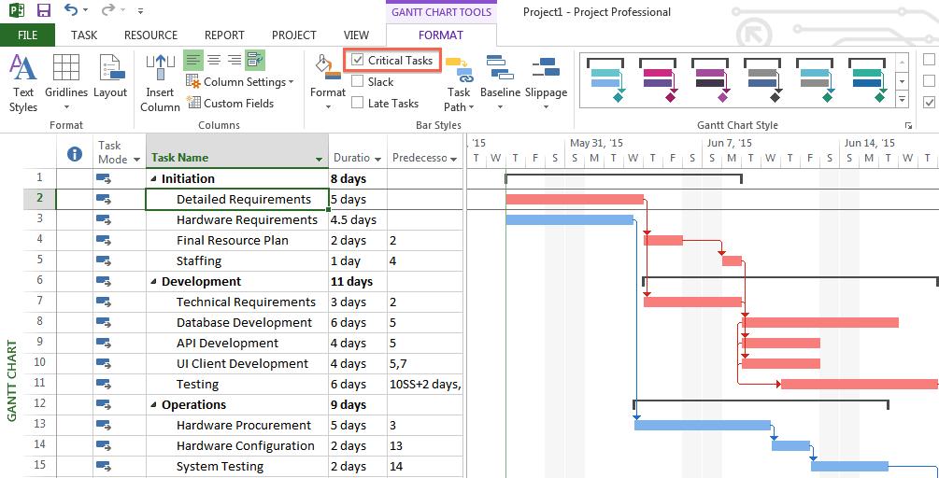
Microsoft Project (cont.)

Slide 12
PERT
PERT stands for Program Evaluation Review Technique
A project management tool used to schedule, organize, and coordinate tasks within a project
Presents a graphic illustration of a project as a network diagram

Slide 13
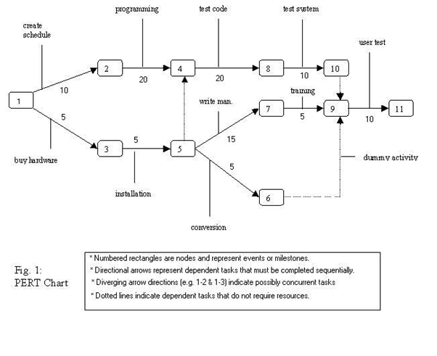
PERT (cont.)

Slide 14
Basecamp
Project Management software which puts an emphasis on communication.
Has a "To-do list" for managing project tasks.
Contains a calendar which displays an overview of the project dates.
Has file sharing features.
Has messaging features for communication between project members.

Slide 15
How they compare
Microsoft Project
Straightforward simple tasks
Integrates well with the other Microsoft office programs
Advanced features difficult to learn
Better versions are expensive
Basecamp
Collaboration focused.
Allows setting/completing tasks for project members.
More focused on the people working on project than the manager.
Simple features

Slide 16
Other options
Zoho Projects
Teamwork Projects
Wrike
Liquid Planner
Activecollab
Many more...

Slide 17
Case Study 1
Can use to manage time efficiently to ensure payroll not missed.
Assign resources effectively
Manage project tasks to ensure nobody is over-worked

Slide 18
Usefulness
Useful for larger projects with more people and resources involved.
Less useful for small university projects.
Could help keep track of deadlines and milestones
Prices are not practical for students generally
Not as many resources to manage

Slide 19
References
https://technologyadvice.com/project-management/
https://searchsoftwarequality.techtarget.com/definition/PERT-chart
https://basecamp.com/
http://en.wikipedia.org/wiki/Project_management_software
https://en.wikipedia.org/wiki/Microsoft_Project
http://www.pcmag.com/article2/0,2817,2380448,00.asp
http://www.web-enable.com/industry/ms_project_tutorial/project_management.asp
http://emilychang.com/ehub/app/project-management-2-0/
http://www.softwareprojects.org/project-management-support.htm
http://www.projectreference.com/#PMSoftware.

